Slide 1
Chapter 1- Introduction

Slide 2
Agenda
What is a software?
Software products
Software costs
What is Software Engineering?
Software Engineering vs. System Engineering
Essential attributes of good software
Software engineering diversity
Application types
Software engineering and the web
SWE: Key Challenges
Software engineering ethics

Slide 3

What is a software?
Software:
Computer programs and
associated documentation.
Software products may be developed for
a particular customer
a general market

Slide 4
Software Products
Generic products
Stand-alone systems that are marketed and sold to any customer who wishes to buy them.
The specification of what the software should do is owned by the software developer and decisions on software change are made by the developer
Examples – PC software such as graphics programs, project management tools; etc.

Slide 5
Software Products
Customized products
Software that is commissioned by a specific customer to meet their own needs.
The specification of what the software should do is owned by the customer for the software and they make decisions on software changes that are required.
Examples – embedded control systems, automation system for a certain company

Slide 6
Software costs
The costs of software on a PC are often greater than the hardware cost.
Software costs more to maintain than it does to develop. For systems with a long life, maintenance costs may be several times development costs.
Software engineering is concerned with cost-effective software development.

Slide 7
Software engineering
Software engineering is concerned with theories, methods and tools for professional software development.
Software engineering is an engineering discipline that is concerned with all aspects of software production from the early stages of system specification through to maintaining the system after it has gone into use.

Slide 8
Software Engineering vs. System Engineering
System engineering is concerned with all aspects of computer-based systems development including hardware, software and process engineering.
Software engineering is part of this more general process

Slide 9
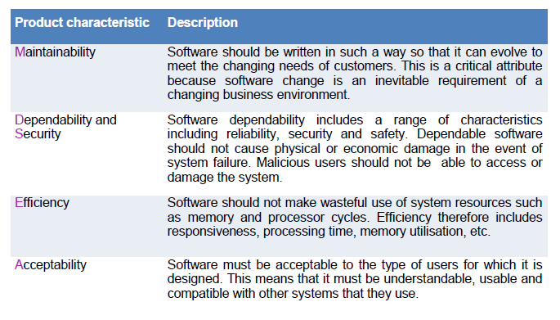
Essential attributes of good software

Slide 10
Maintainability
Software should be written in such a way so that it can evolve to meet the changing needs of customers.
This is a critical attribute because software change is an inevitable requirement of a changing business environment.

Slide 11
Dependability and security
Software dependability includes a range of characteristics including reliability, security and safety.
Dependable software should not cause physical or economic damage in the event of system failure.
Malicious users should not be able to access or damage the system.

Slide 12
Efficiency
Software should not make wasteful use of system resources such as memory and processor cycles.
Efficiency therefore includes responsiveness, processing time, memory utilisation, etc.

Slide 13
Acceptability
Software must be acceptable to the type of users for which it is designed.
This means that it must be understandable, usable and compatible with other systems that they use.

Slide 14
Software engineering diversity
SWE Methods is not Constant!
There are many different types of software system.
no universal set of software techniques that is applicable to all of these.
The software engineering methods and tools used depend on
the type of application being developed,
the requirements of the customer and
the background of the development team.

Slide 15
Application types
Stand-alone applications
These are application systems that run on a local computer, such as a PC (no need for network connectivity) e.g.: Office, photo manipulation.
Interactive transaction-based applications
Applications that execute on a remote computer and are accessed by users from their own PCs or terminals. These include web applications such as e-commerce applications. (security, large data)

Slide 16
Application types
Embedded control systems (most popular)
These are software control systems that control and manage hardware devices. (Mobile phones, cars, microwave, ..)
Data collection systems
These are systems that collect data from their environment using a set of sensors and send that data to other systems for processing.

Slide 17
Application types
Systems of systems
These are systems that are composed of a number of other software systems.
An online banking system that handles loan requests and which connects to a credit reference system provided by credit reference agency to check the credit of applicants.
An emergency information system that integrates information from police, ambulance, fire and coastguard services about the assets available to deal with civil emergencies such as flooding and large-scale accidents.

Slide 18
Application types
Systems for modelling and simulation
These are systems that are developed by scientists and engineers to model physical processes or situations, which include many, separate, interacting objects. (high performance , parallel systems)

Slide 19
Application types
Batch processing systems
These are business systems that are designed to process data in large batches. They process large numbers of individual inputs to create corresponding outputs. (e.g. phone billing system)
Entertainment systems
These are systems that are primarily for personal use and which are intended to entertain the user. (e.g. Games , Interaction comes first)

Slide 20
Software engineering and the web
The Web is now a platform for running application.
organizations are increasingly developing web-based systems rather than local systems.
Web services allow application functionality to be accessed over the web.
Cloud computing is an approach to the provision of computer services where applications run remotely on the ‘cloud’.
Users do not buy software but pay according to use.

Slide 21
SWE: Key Challenges
Coping with increasing diversity;
Increasingly, systems are required to operate as distributed systems across networks that include different types of computer and mobile devices.
demands for reduced delivery times;
Business and society are changing incredibly quickly as emerging economies develop and new technologies become available. They need to be able to change their existing software and to rapidly develop new software.
developing trustworthy software.
As software is intertwined with all aspects of our lives, it is essential that we can trust that software. (internet-based payment)

Slide 22
Professional and Ethical Responsibility
Software engineering involves wider responsibilities than simply the application of technical skills.
Software engineers must behave in an honest and ethically responsible way if they are to be respected as professionals.
Ethical behaviour is more than simply upholding the law.

Slide 23

Issues of Professional Responsibility
Confidentiality
Engineers should normally respect the confidentiality of their employers or clients irrespective of whether or not a formal confidentiality agreement has been signed.
Competence
Engineers should not misrepresent their level of competence. They should not knowingly accept work which is outwith their competence.

Slide 24

Issues of Professional Responsibility
Intellectual property rights
Engineers should be aware of local laws governing the use of intellectual property such as patents, copyright, etc.
Computer misuse
Software engineers should not use their technical skills to misuse other people’s computers. Computer misuse ranges from relatively trivial (game playing) to extremely serious (dissemination of viruses).

Slide 25
Task => Read ::
ACM/IEEE Code of Ethics

